Slide 1
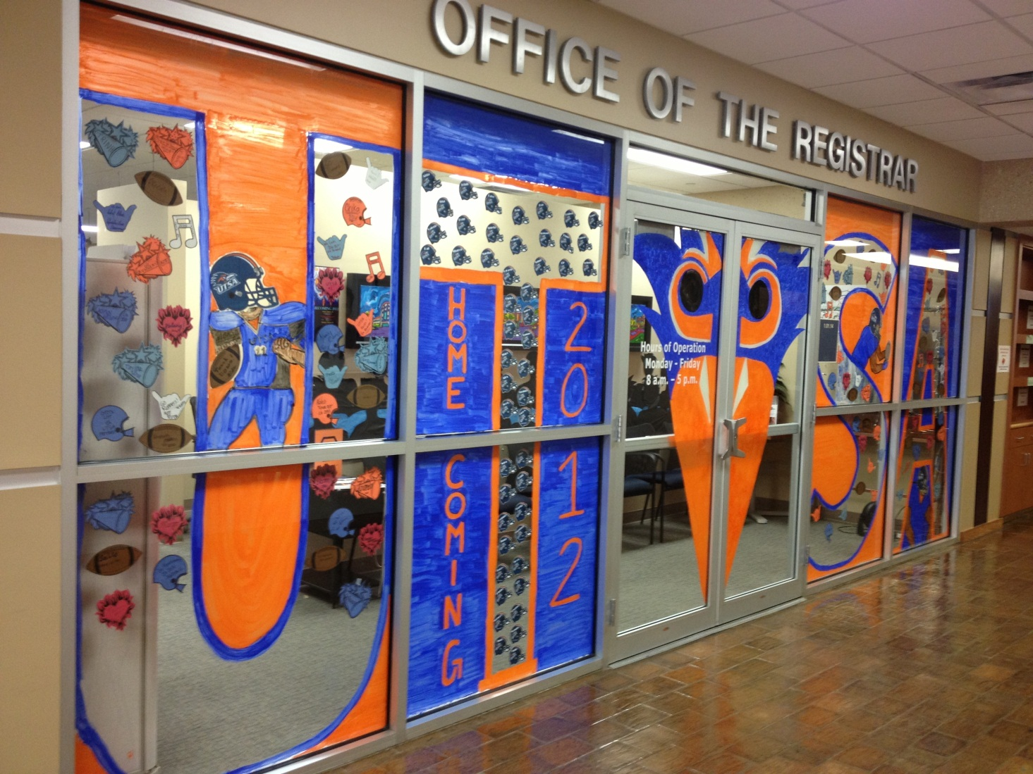
Office of the Registrar

Slide 2
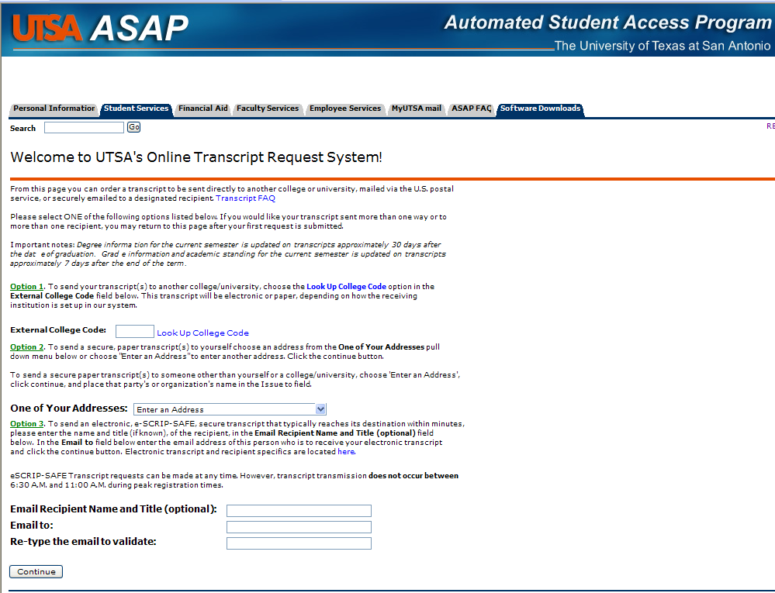

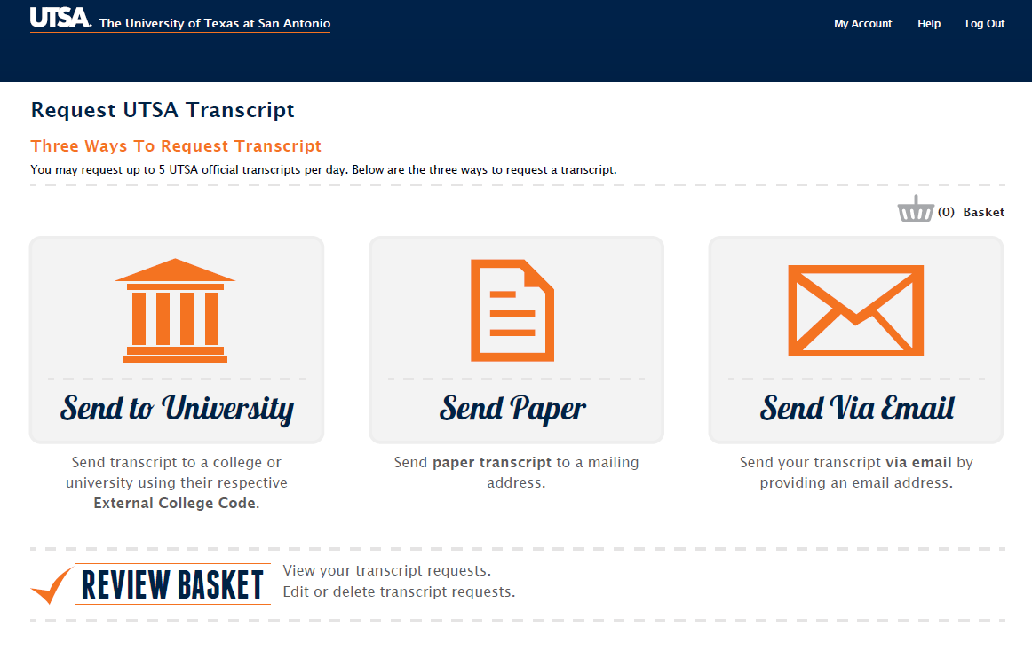
Moving transcript request system out of ASAP
More user friendly
ETA October
Questions?
Ask Cié

Slide 3


utsa.edu/registrar/waitlist/
Your seat is waiting!
Full campus implementation
Needs met/unmet tracking available
Exploring WL in late registration
Waitlisting ends for FL ‘13 August 17
Questions?
Ask Cié

Slide 4
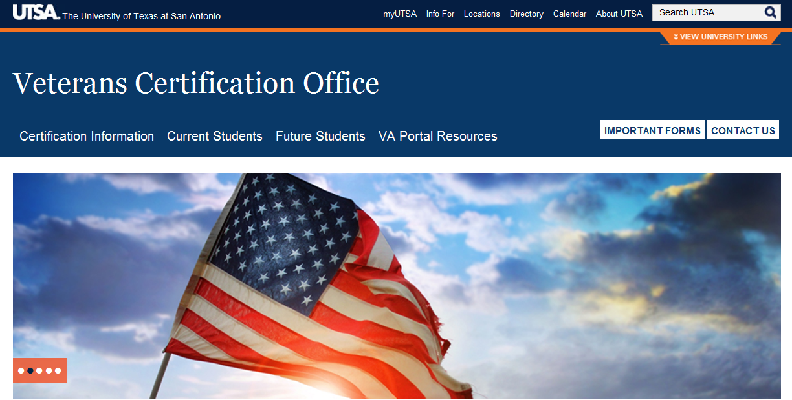
VA VetSuccess on Campus Program
2 seasoned VA counselors on-site, full-time
Streamline access to VA services and information
Identify VA benefits, enrolling in VA healthcare, provide counseling
Contact information can be obtained through the Veteran Portal
Questions?
Ask Judy Moreno

Slide 5

Business Objects (BOXI) 4.0 upgrade – training sessions coming soon!
Improved dashboard capabilities – interactive/real-time and drill-down capabilities
Integration to Microsoft SharePoint
Ability to freeze WEBI report headers, columns and rows (like Excel)
6 new chart types and additional formatting choices
Multiple users can open/edit same workspace at the same time
New management and audit features to manage system resources
Coming Summer 2014 – EXPLORER! (it’s like Google for Banner!)
Questions?
Ask Martha LaRoque

Slide 6
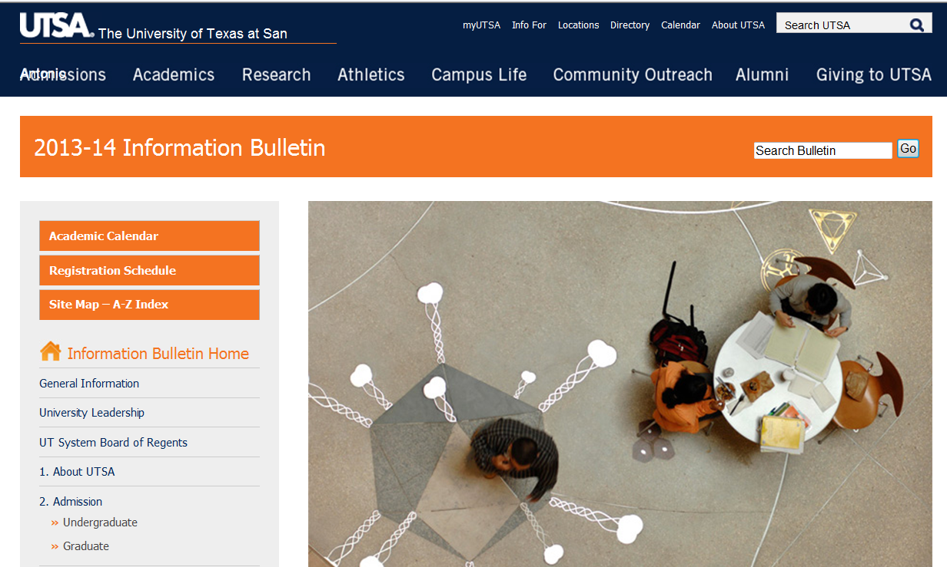
Content Management System (CMS)
Streamline the update process/increased accuracy of catalogs and Info Bulletin.
No longer print catalogs
UG catalog – annual
GR catalog – biennial
Authors/reviewer training will occur this Fall
THIS INCLUDES YOU ☺
Questions?
Ask Johanna Hunziker

Slide 7
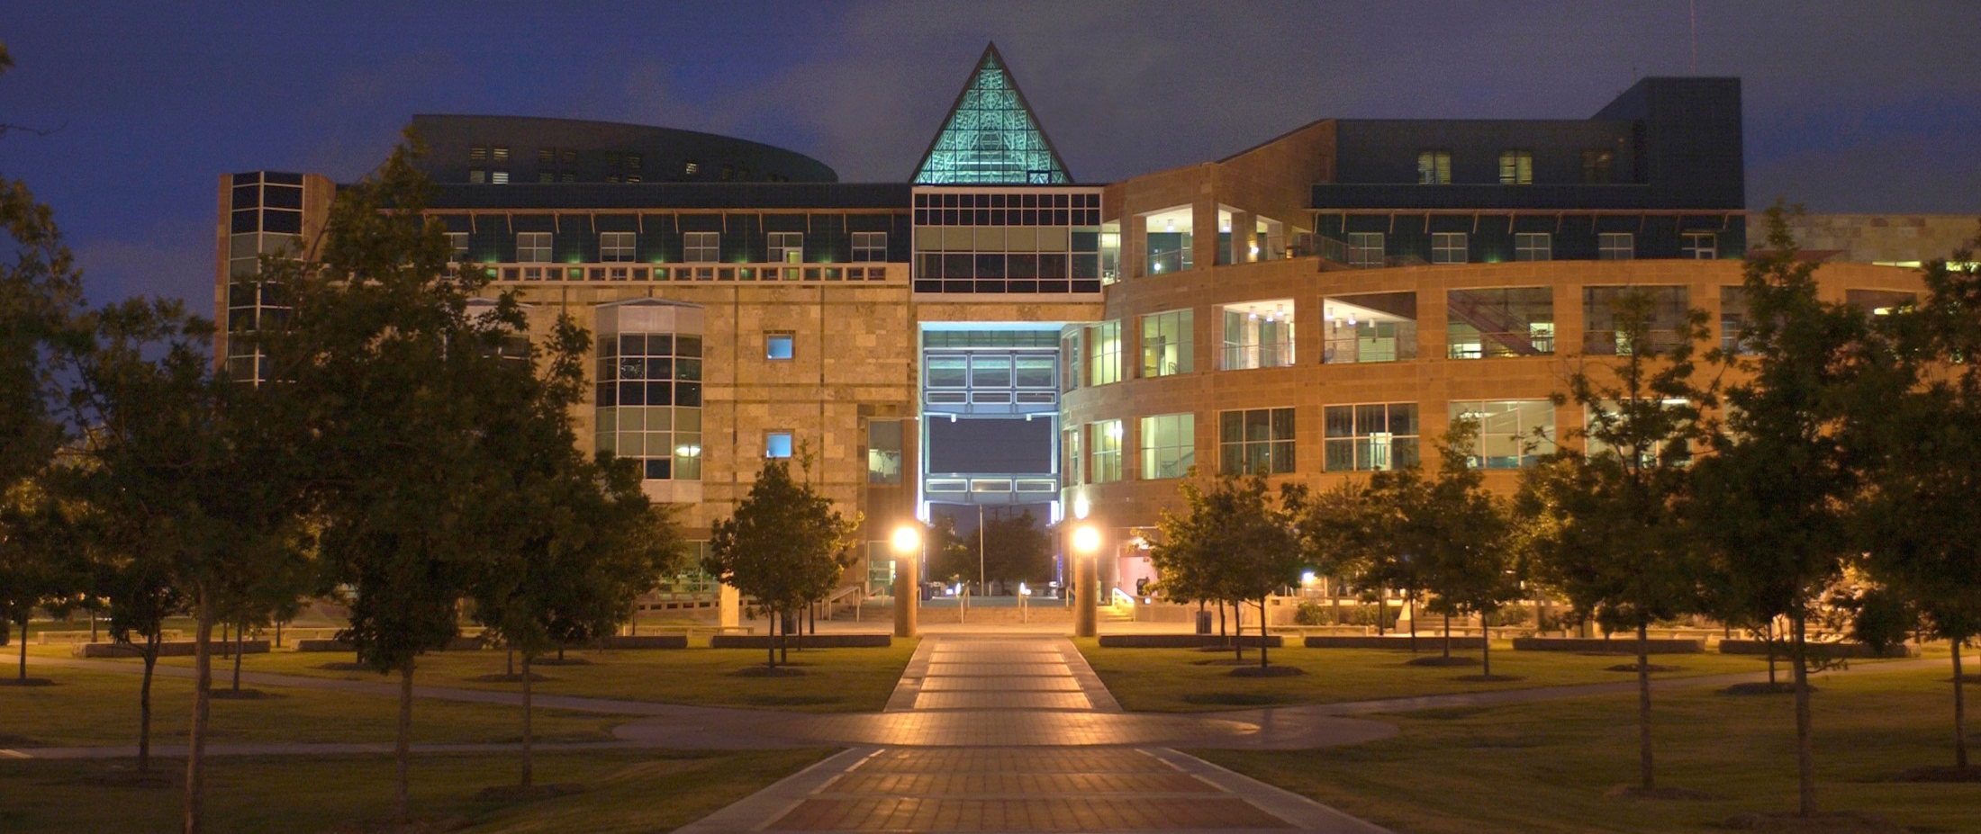
Downtown Operations
In addition to Starbucks…the cafeteria has been renovated
Master Calendar for events
Wayfinder project signage installed
SGA will meet with Dr. Zapata’s staff
Student Veteran outreach teaming up with Admissions
Questions?
Ask Fred Hample

